Slide 1
Photographic Gems: Mining, Polishing, and Displaying Them
Rick Swanson
Steele County Historical Society
August 9, 2018

Slide 2
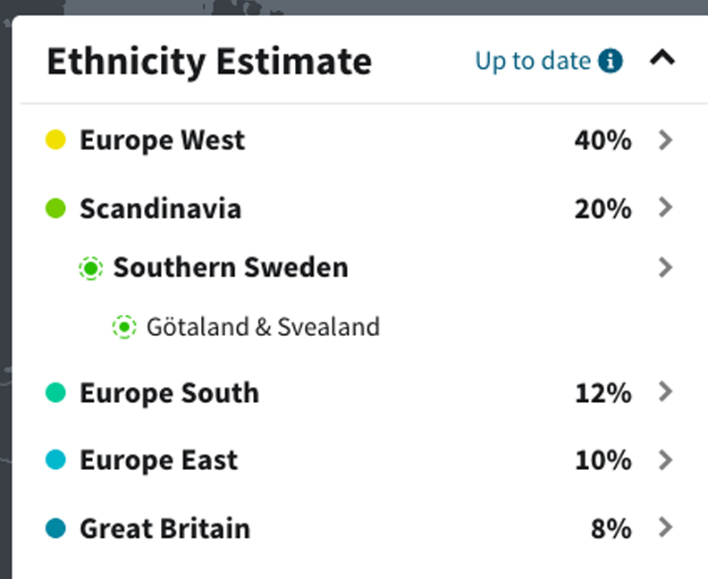
About Me - Rick
Lifelong Minnesotan
Ancestry DNA says I’m:
Photographer, business owner, musician

Slide 3
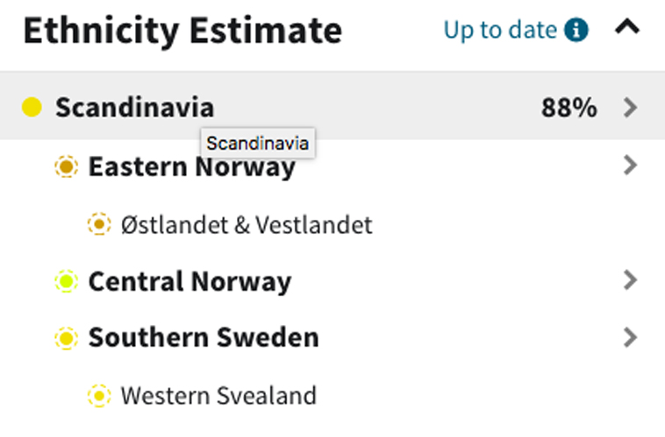
About Me - Jan
Lifelong Minnesotan
Ancestry DNA says I’m:
LPN, painter, family historian

Slide 4
But enough about us…
Tell me a little about you:
  Primary ancestral home?
  Do you have a family tree?
  Do you have at least one picture of…
    Your grandparents?
    Your great grandparents?
    Your great-great grandparents?

Slide 5
Photographic Gems: Mining
a. Sources
  Family albums
  Internet
  Books
  County historical societies
  other? contacting studios?

Slide 6
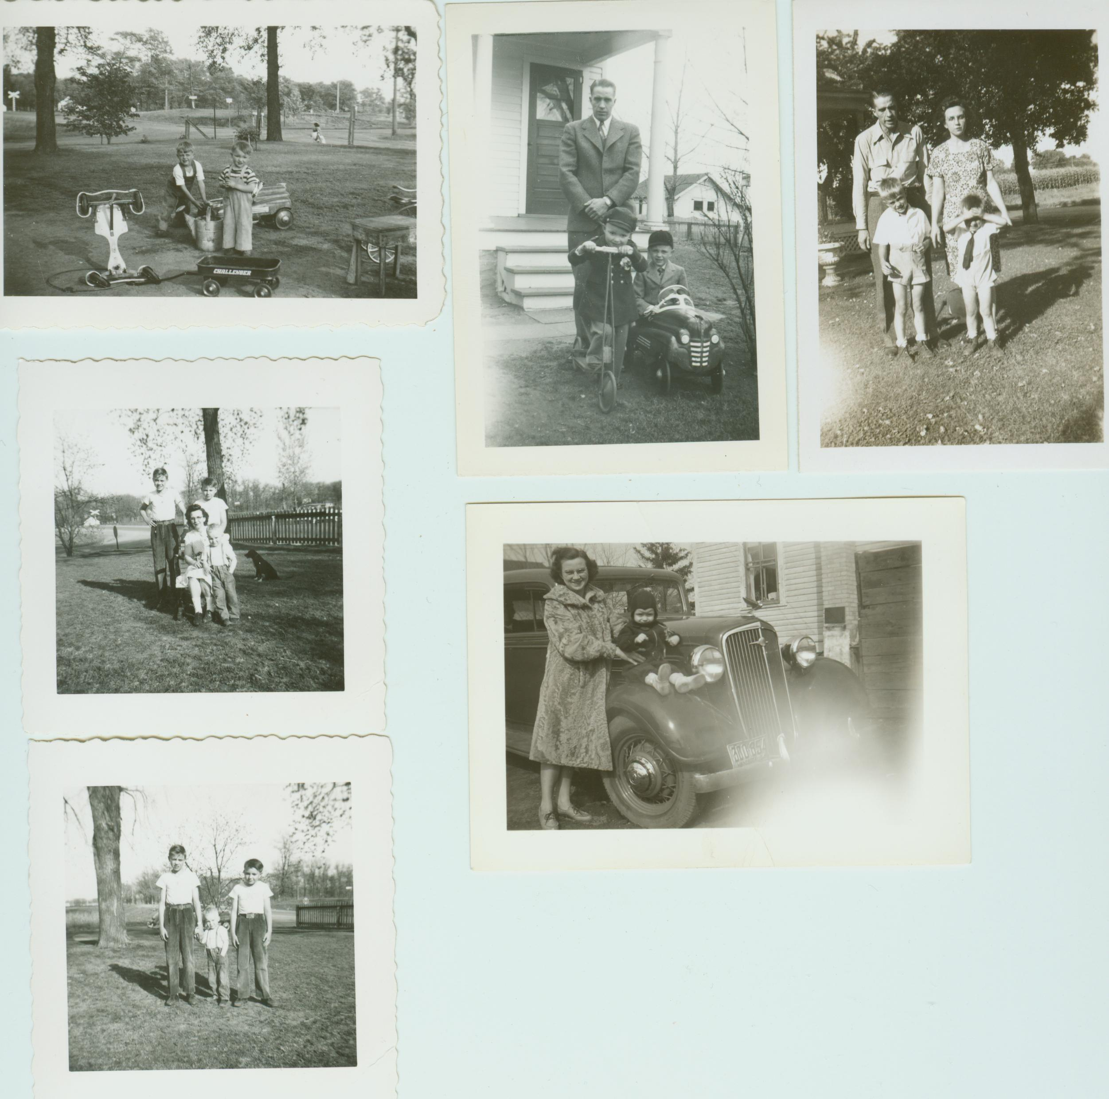
Photographic Gems: Mining
a. Sources
  Family albums

Slide 7
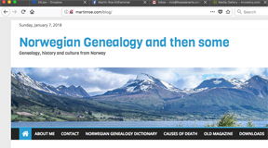
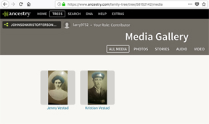
Photographic Gems: Mining
a. Sources
  Internet

Slide 8
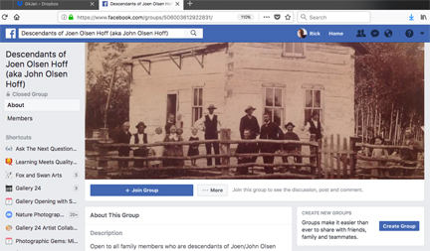
Photographic Gems: Mining
a. Sources
  Internet

Slide 9

Photographic Gems: Mining
a. Sources
  Books

Slide 10
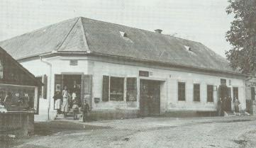
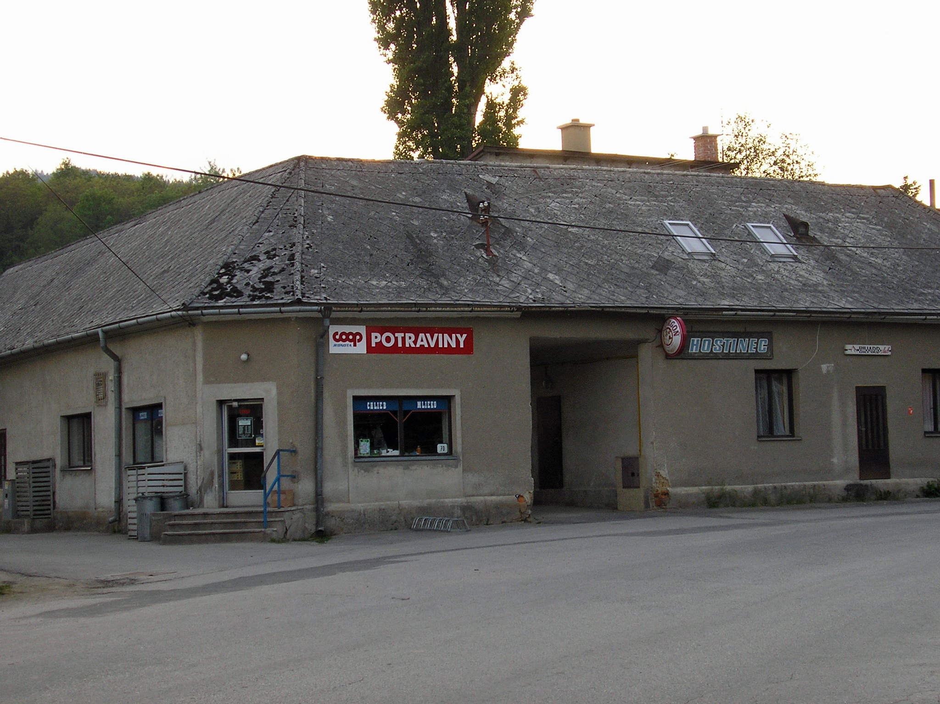
Photographic Gems: Mining
a. Sources
  Books

Slide 11

Photographic Gems: Mining
a. Sources
  Books

Slide 12
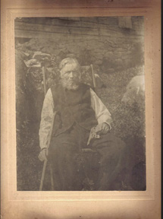
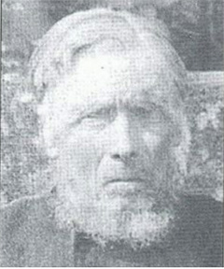
Photographic Gems: Mining
a. Sources
  Books

Slide 13
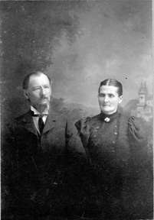
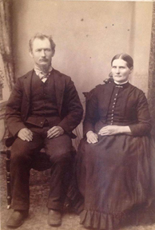
Photographic Gems: Mining
a. Sources
  County historical societies and museums

Slide 14
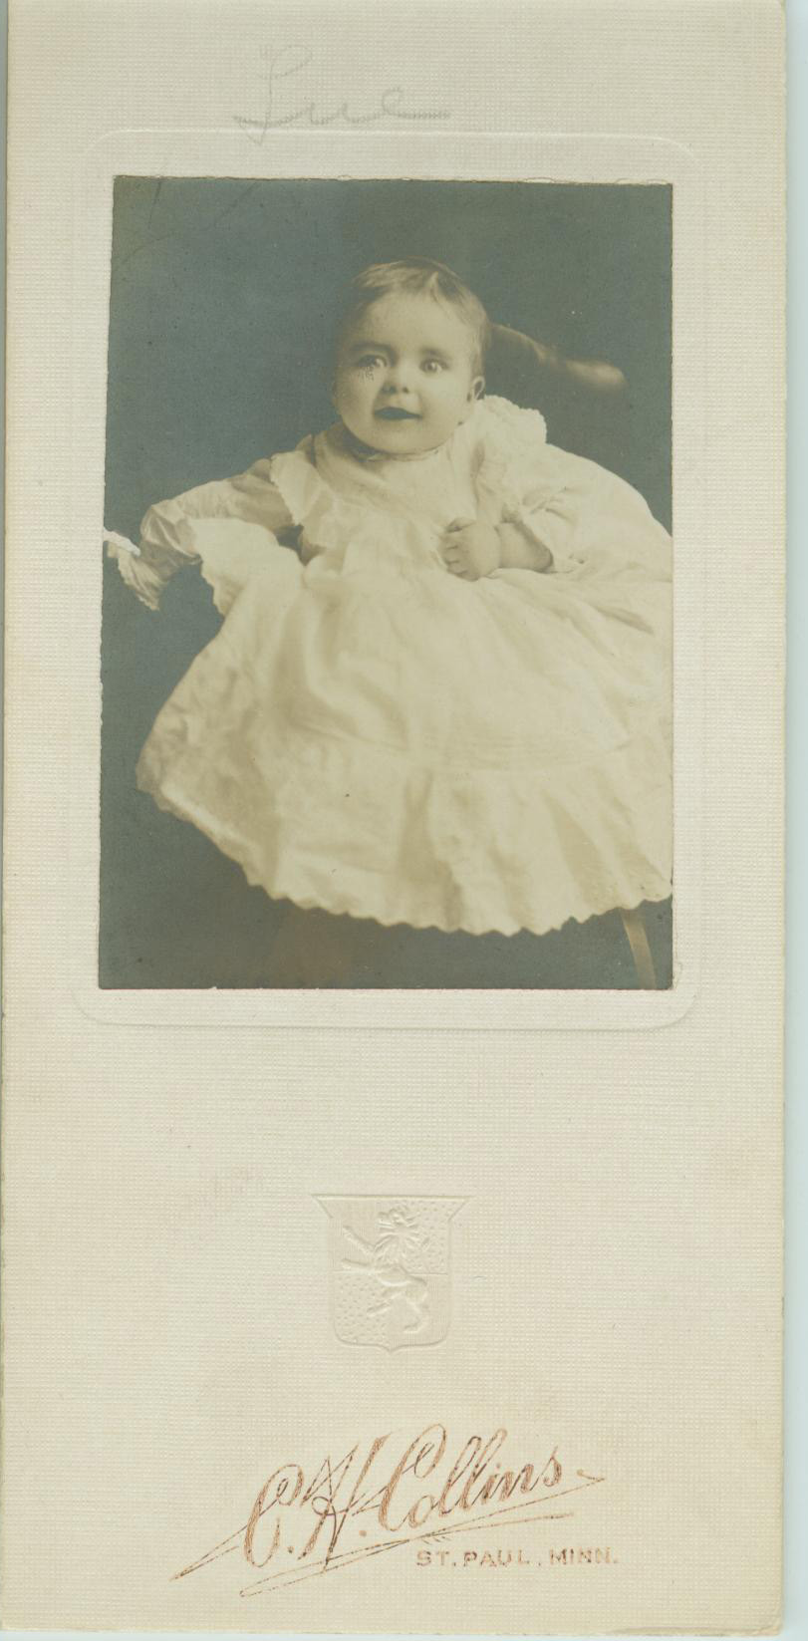
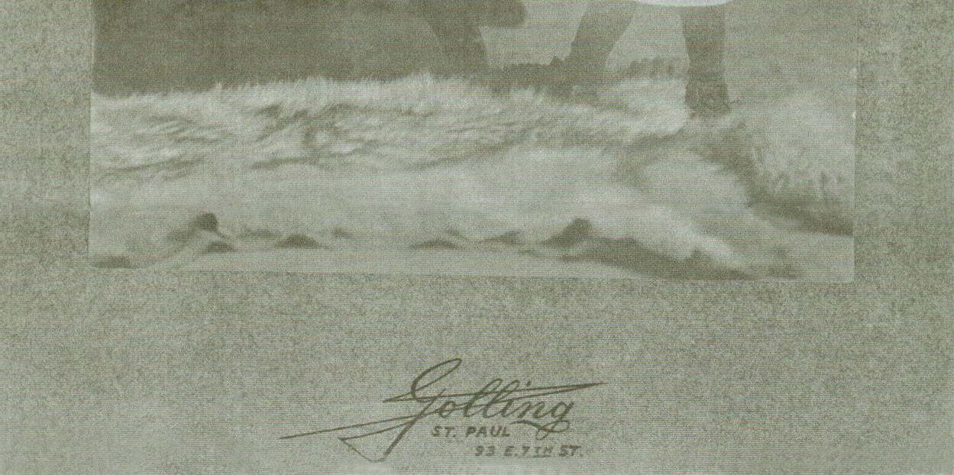
Photographic Gems: Mining
a. Sources
  other? contacting studios?

Slide 15
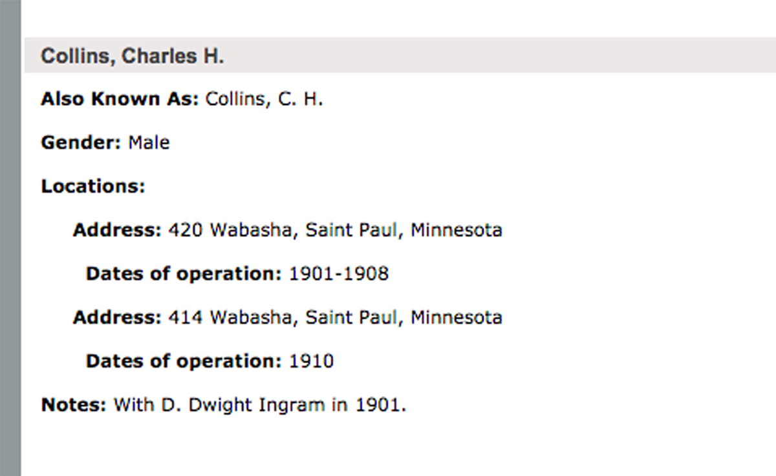
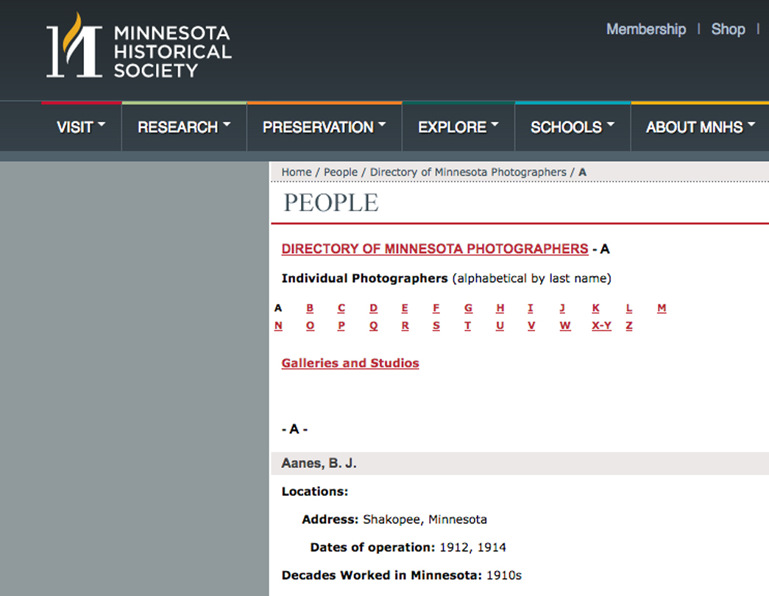
Photographic Gems: Mining
a. Sources
  other? contacting studios?

Slide 16
Photographic Gems: Mining
Your Turn
  Show and tell

Slide 17
Photographic Gems: Mining
b. Getting copies
  scanning
  photographing
  photographing behind glass
  tips
  negotiating with relatives

Slide 18
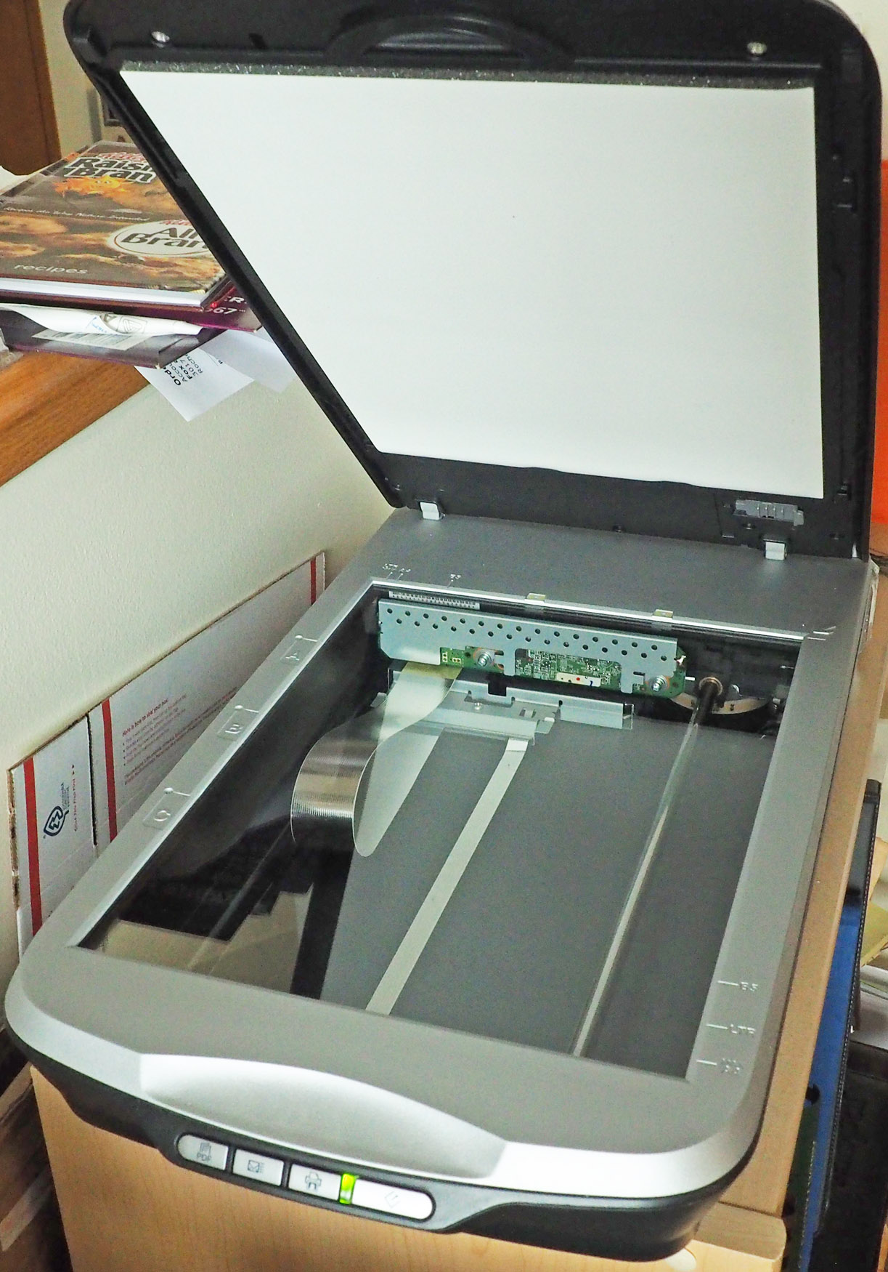
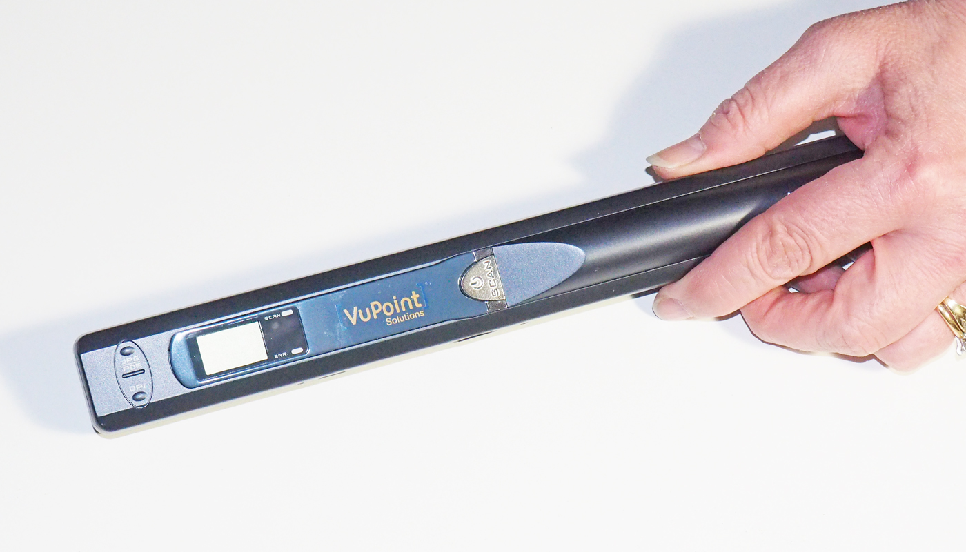
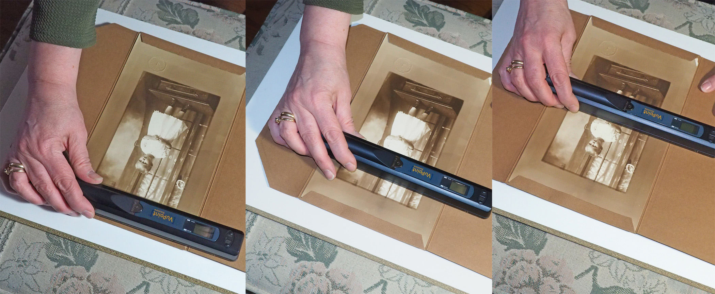
Photographic Gems: Mining
b. Getting copies
  Scanning

Slide 19
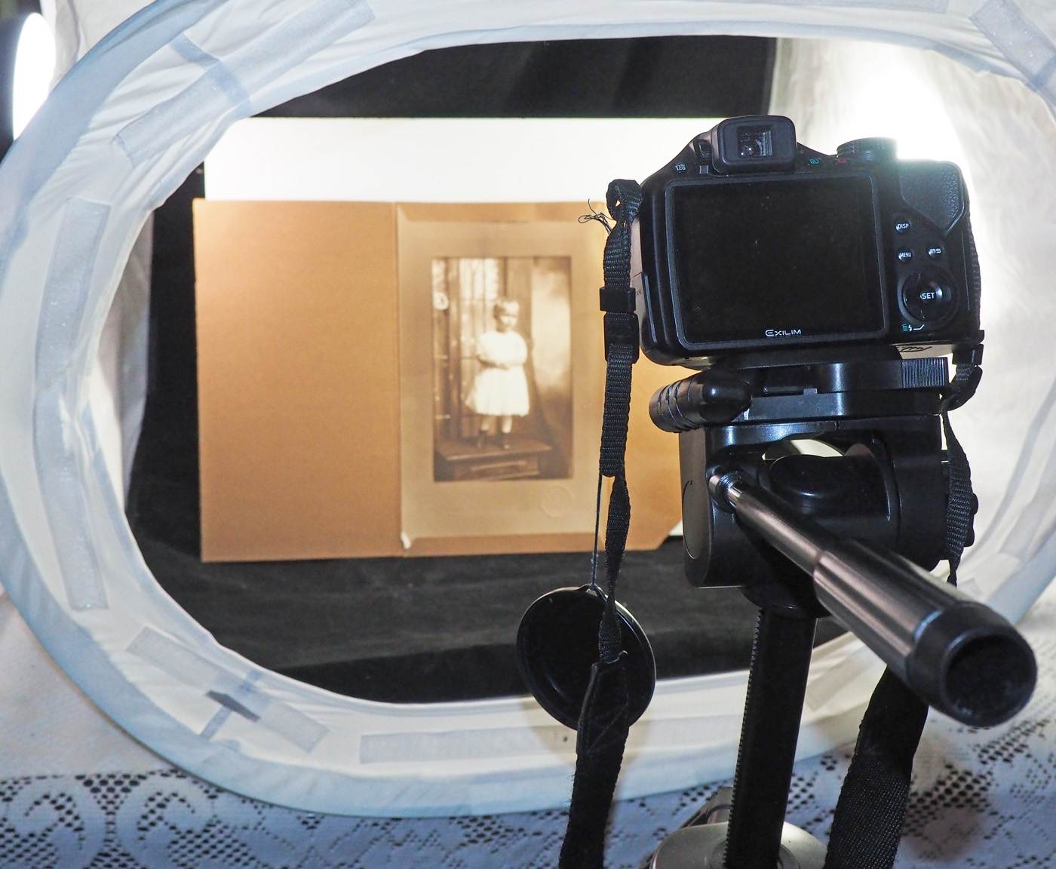
Photographic Gems: Mining
b. Getting copies
  Photographing

Slide 20
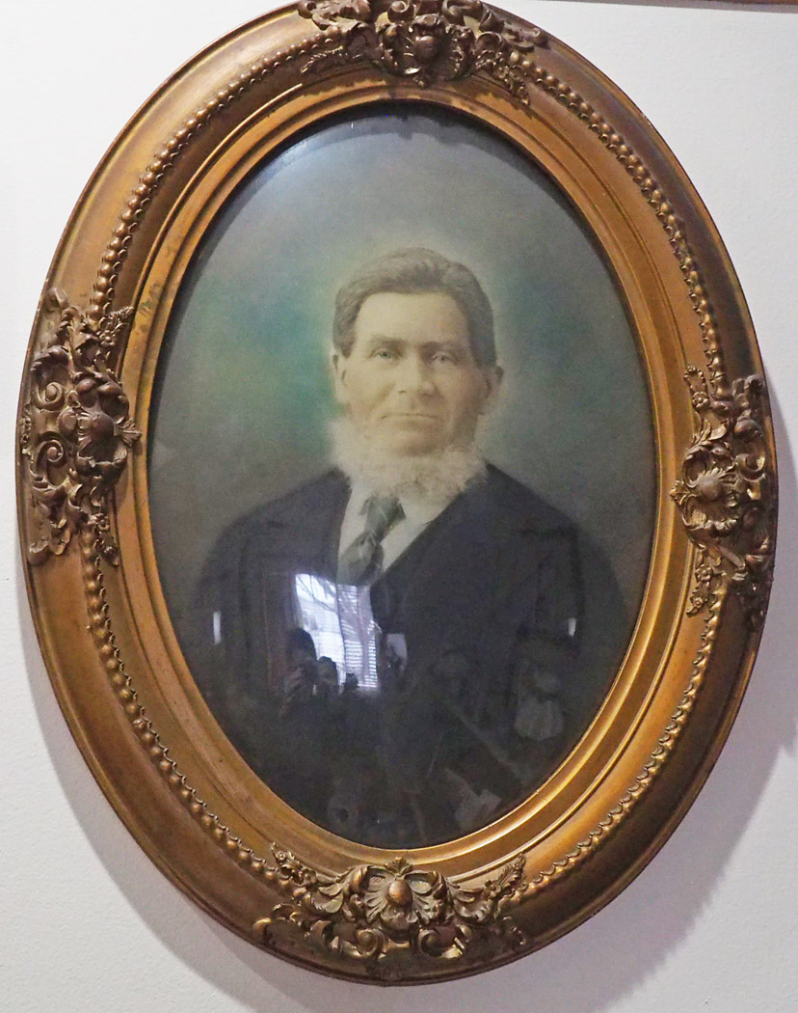
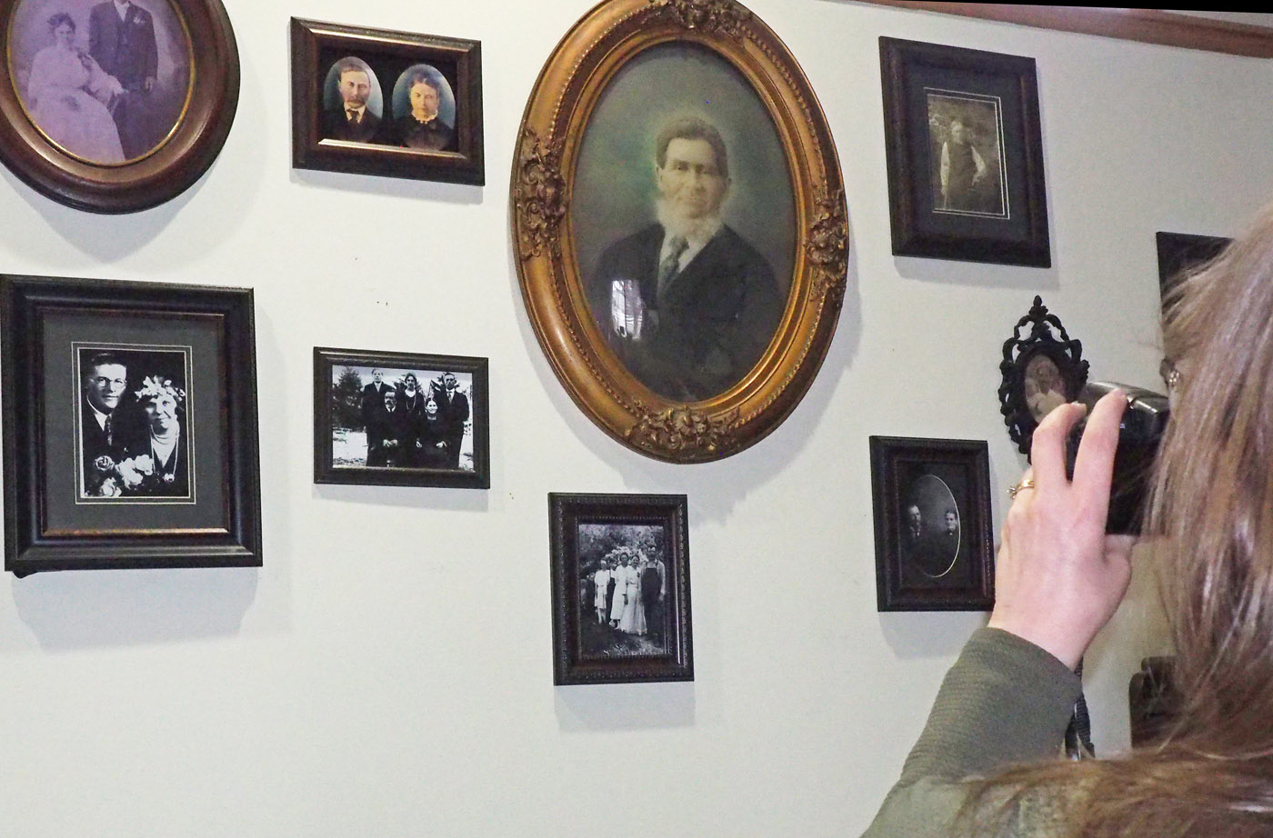
Photographic Gems: Mining
b. Getting copies
  photographing behind glass

Slide 21
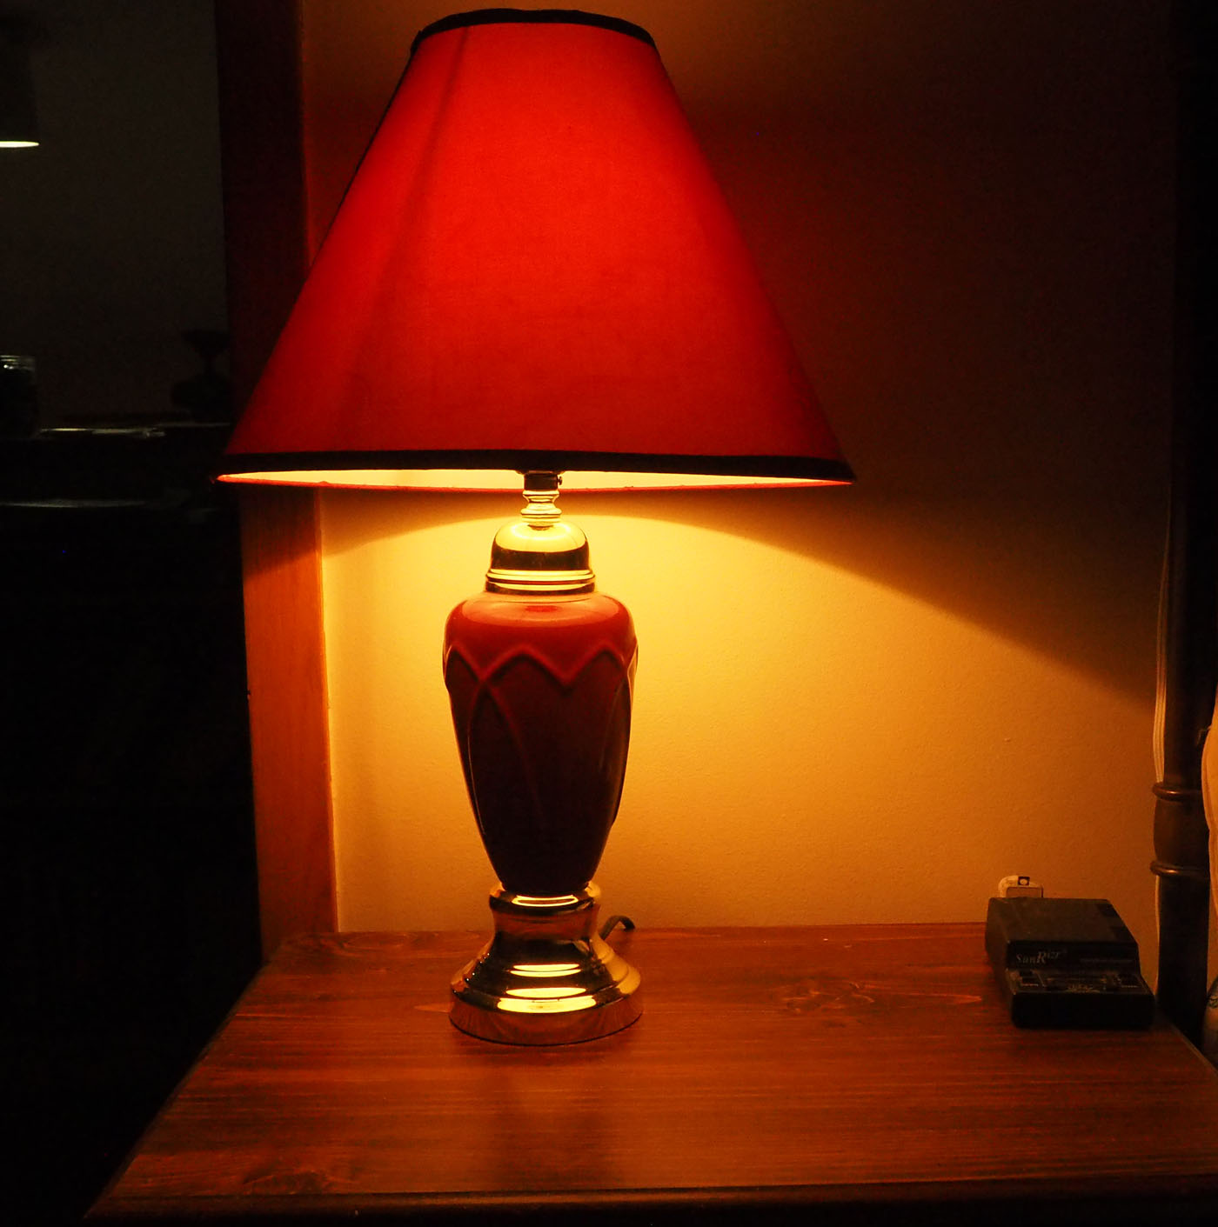
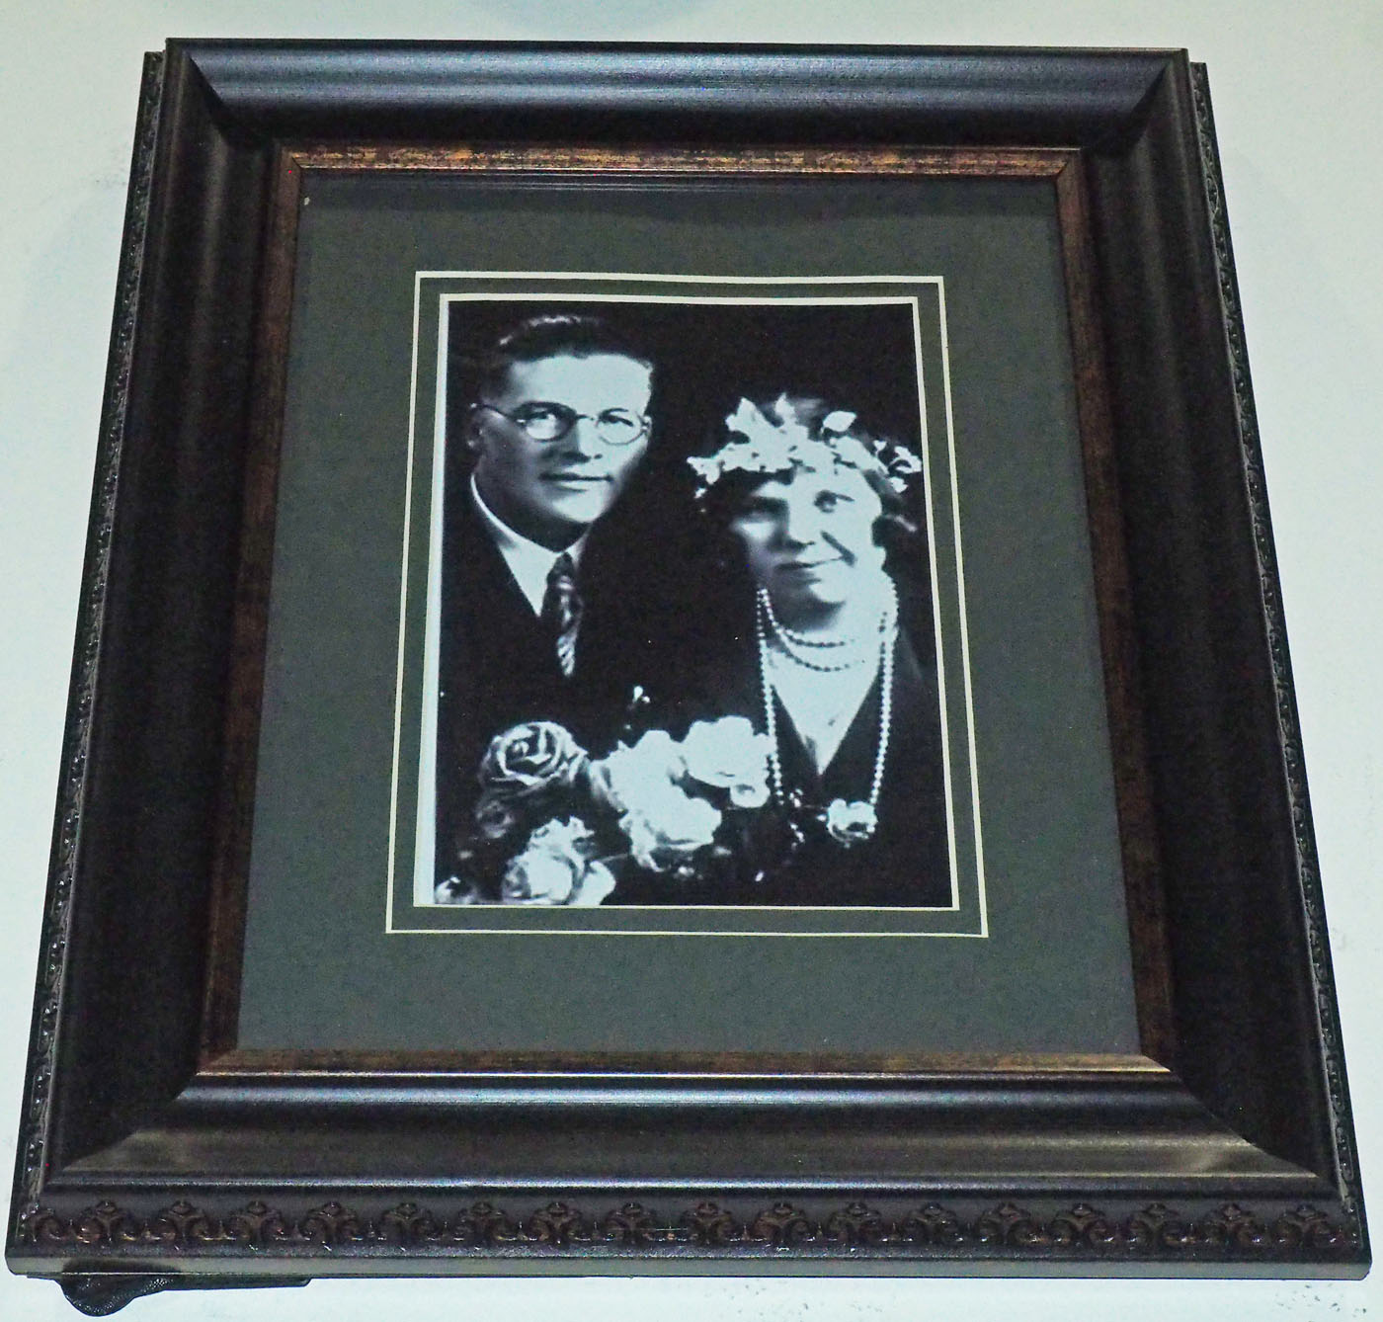
Photographic Gems: Mining
b. Getting copies
  Tips

Slide 22
Photographic Gems: Mining
b. Getting copies
  negotiating with relatives

Slide 23
Photographic Gems: Polishing
a. Stage one: dust, cracks, tears, cropping
b. Stage two: fading, discoloration, stains, glare
c. Stage three: replacing, adding embellishments, vignetting, re-sizing

Slide 24

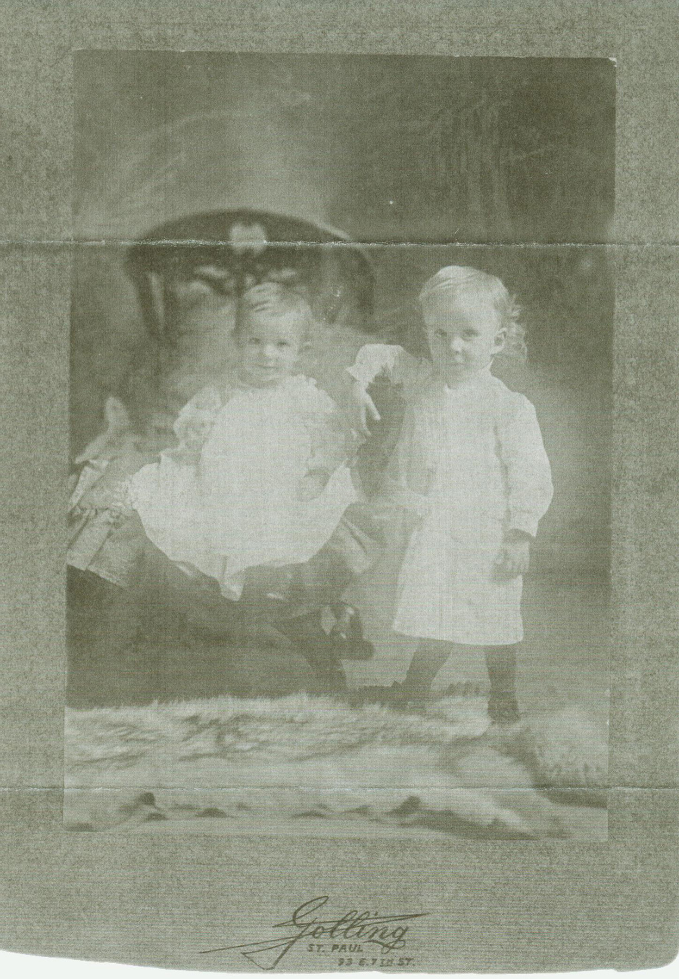
Photographic Gems: Polishing
a. Stage one: dust, cracks, tears, cropping

Slide 25
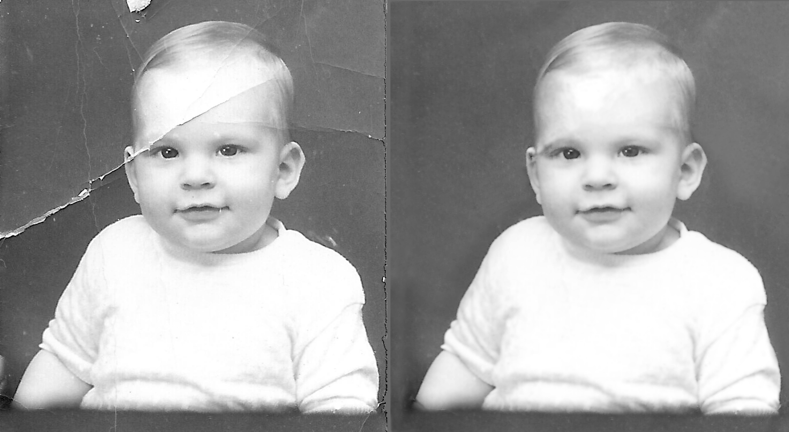
Photographic Gems: Polishing
a. Stage one: dust, cracks, tears, cropping

Slide 26
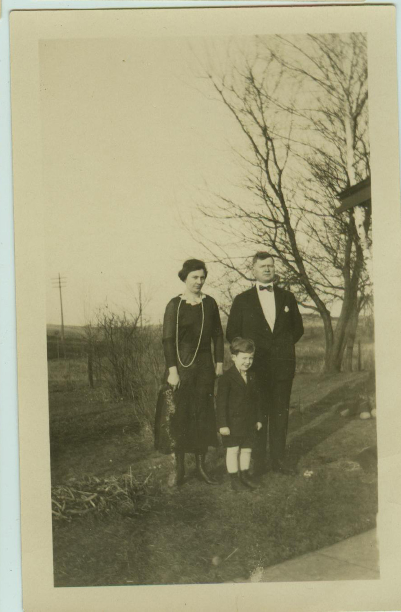
Photographic Gems: Polishing
a. Stage one: dust, cracks, tears, cropping

Slide 27
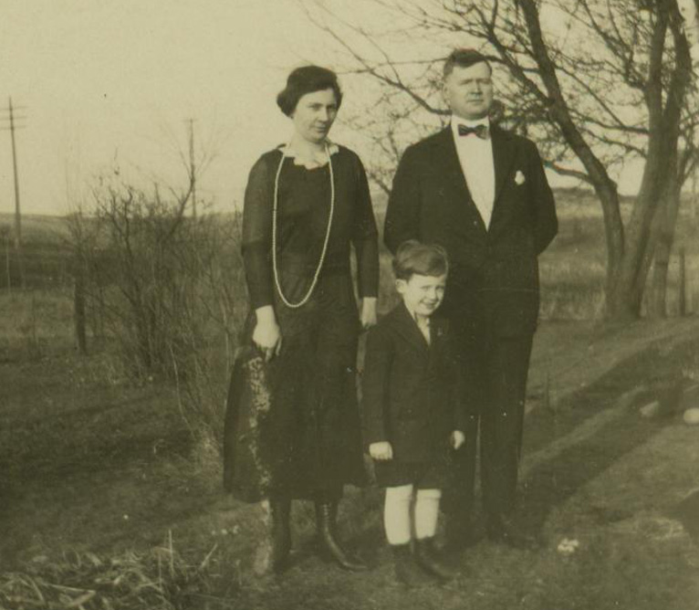
Photographic Gems: Polishing
a. Stage one: dust, cracks, tears, cropping

Slide 28
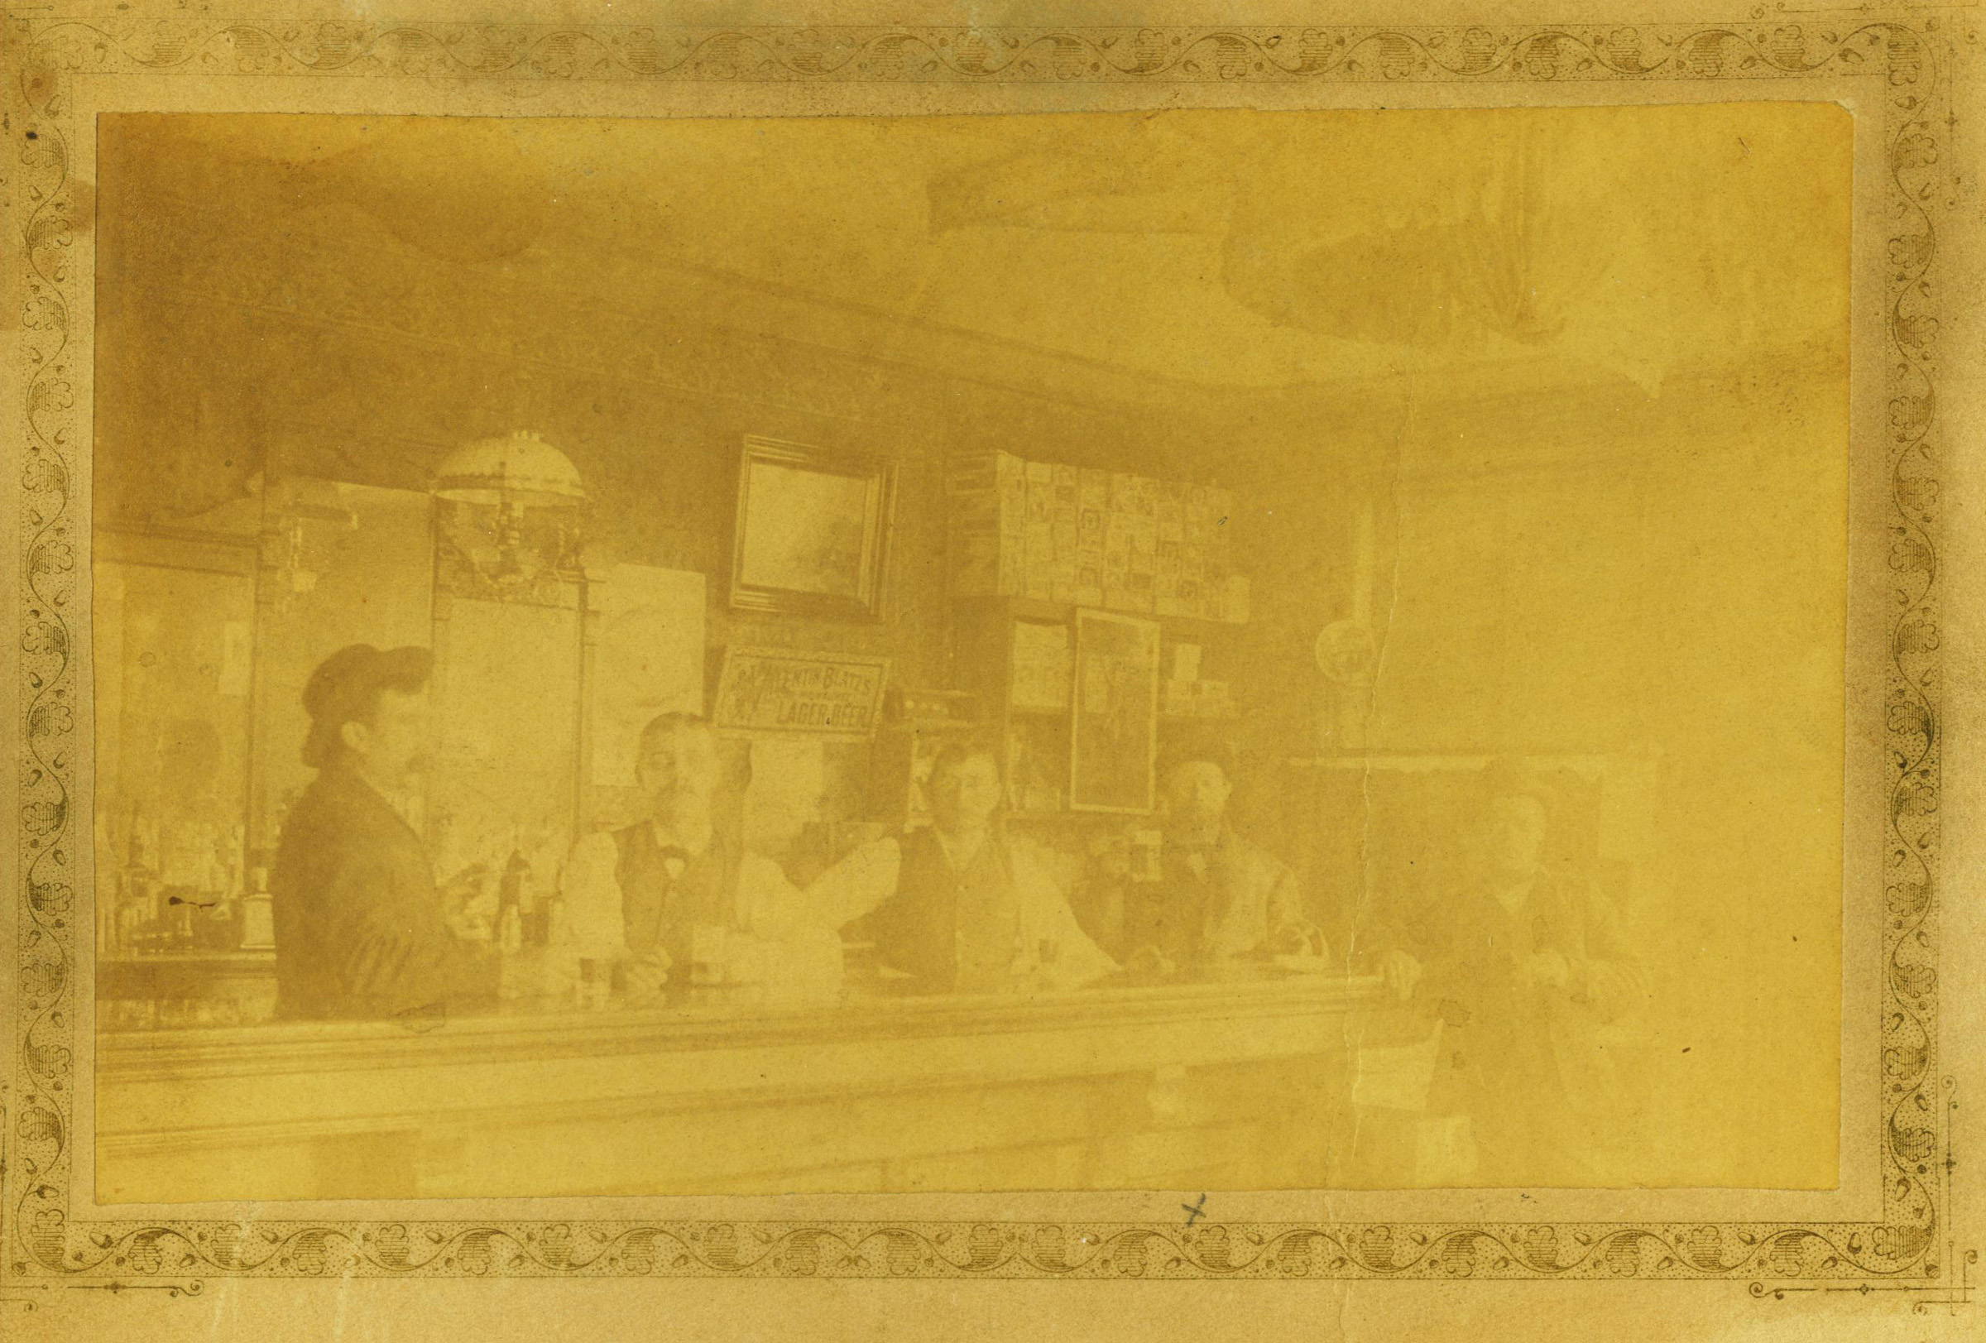
Photographic Gems: Polishing
b. Stage two: fading, discoloration, stains, glare

Slide 29
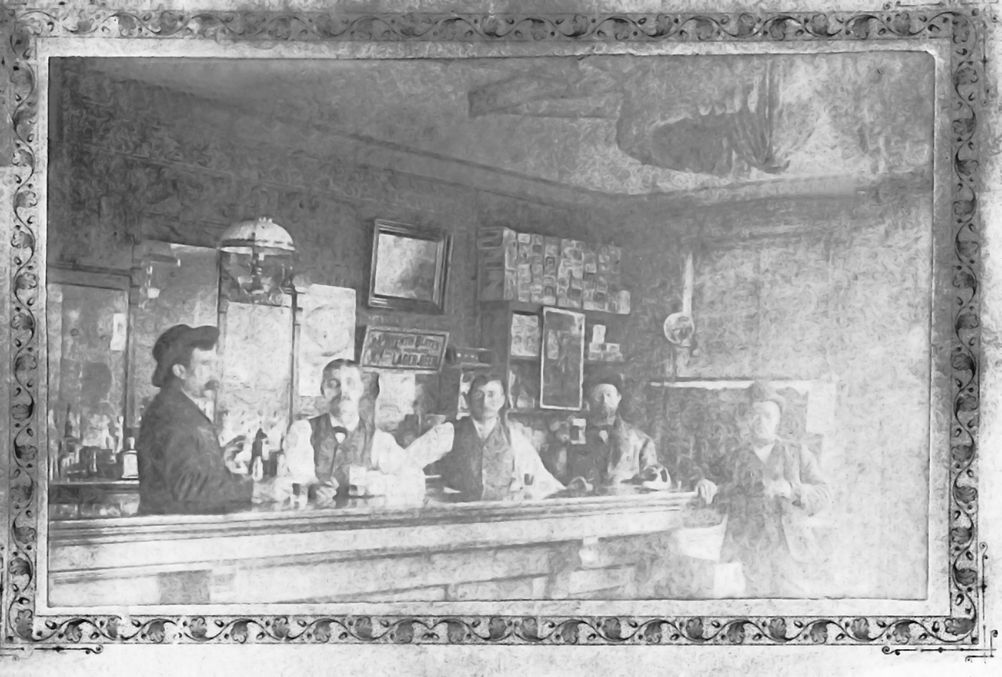
Photographic Gems: Polishing
b. Stage two: fading, discoloration, stains, glare

Slide 30
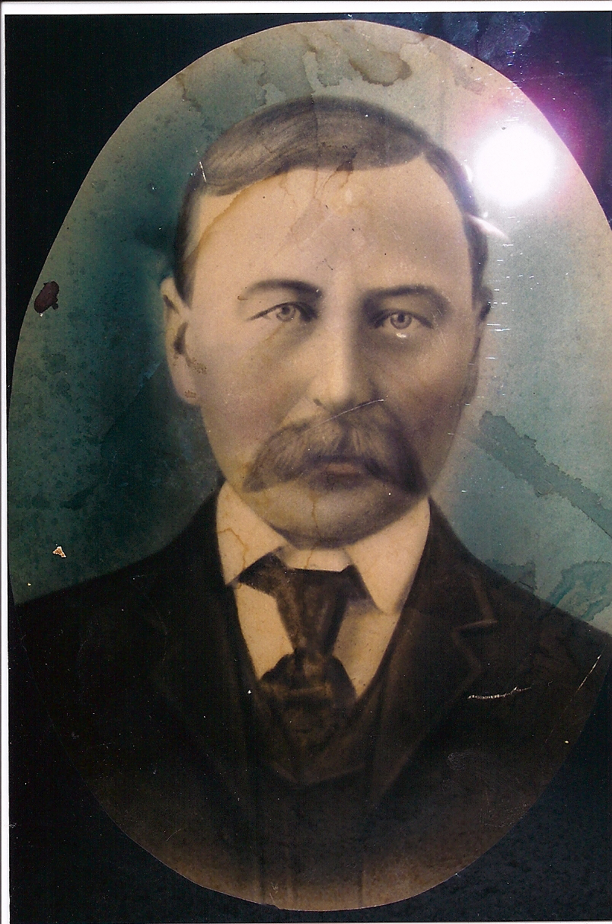
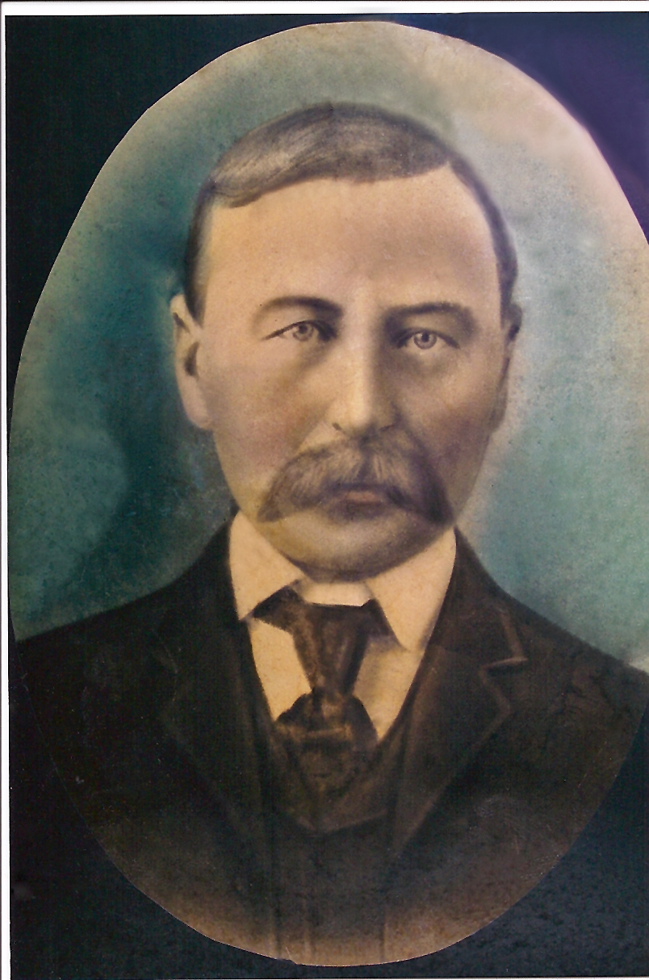
Photographic Gems: Polishing
b. Stage two: fading, discoloration, stains, glare

Slide 31
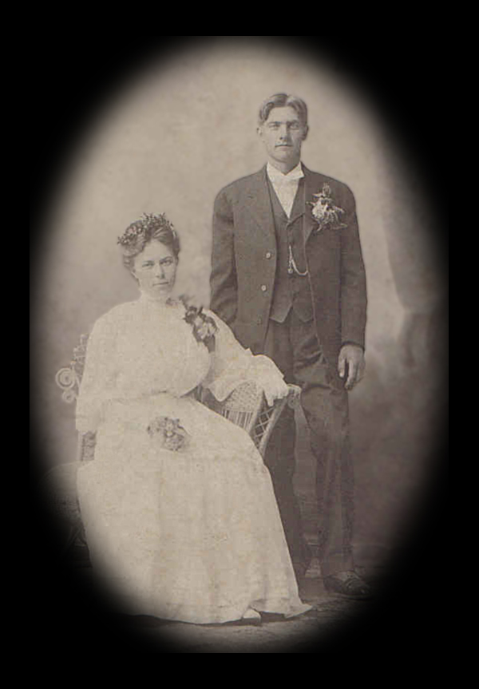
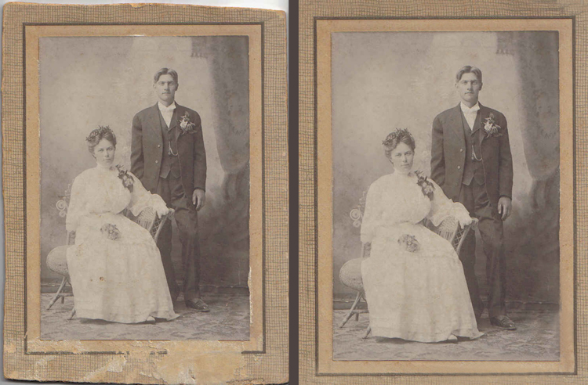
Photographic Gems: Polishing
c. Stage three: replacing, extracting, adding embellishments, vignetting, re-sizing

Slide 32
Photographic Gems: Polishing
Your turn
  What flaws do you see in your photos?
  What would you try to correct?

Slide 33
Photographic Gems: Displaying
a. framed art
b. electronic trees
c. wall displays
d. albums
e. other displays

Slide 34
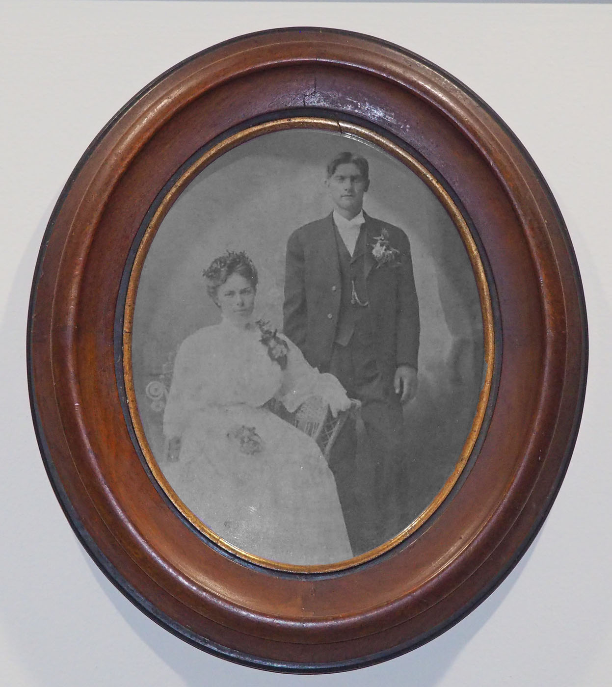
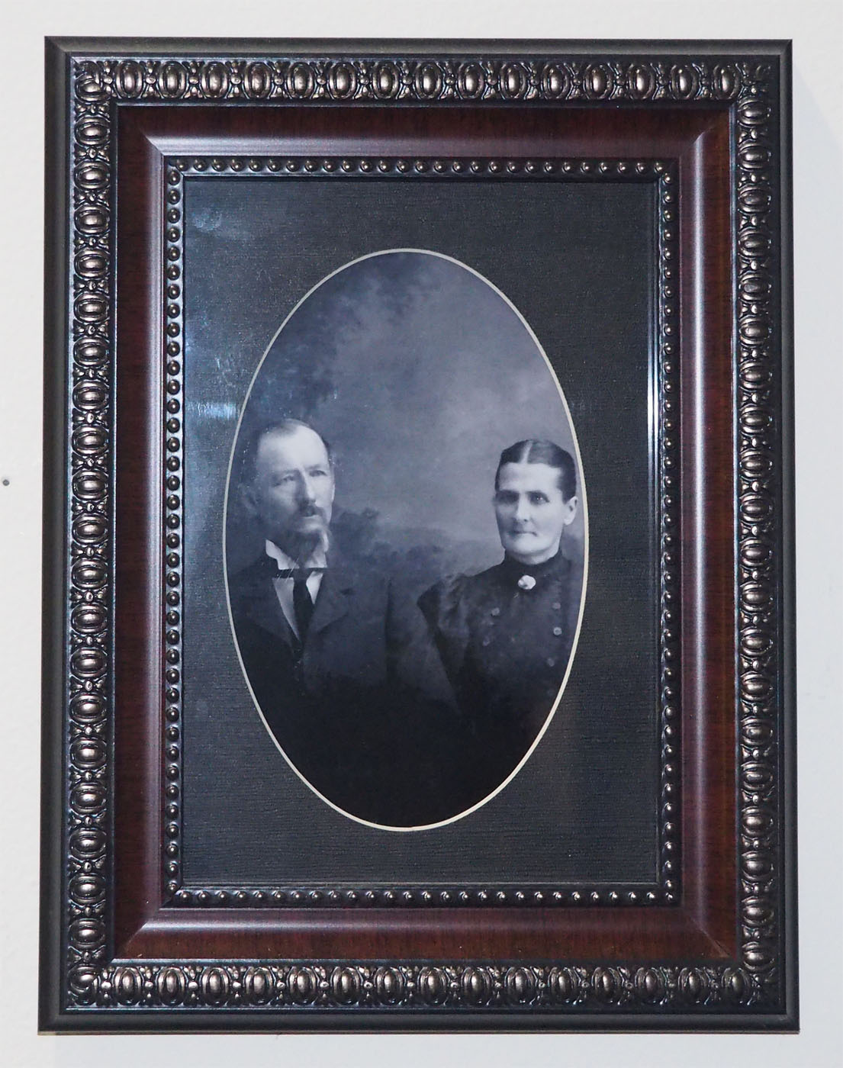
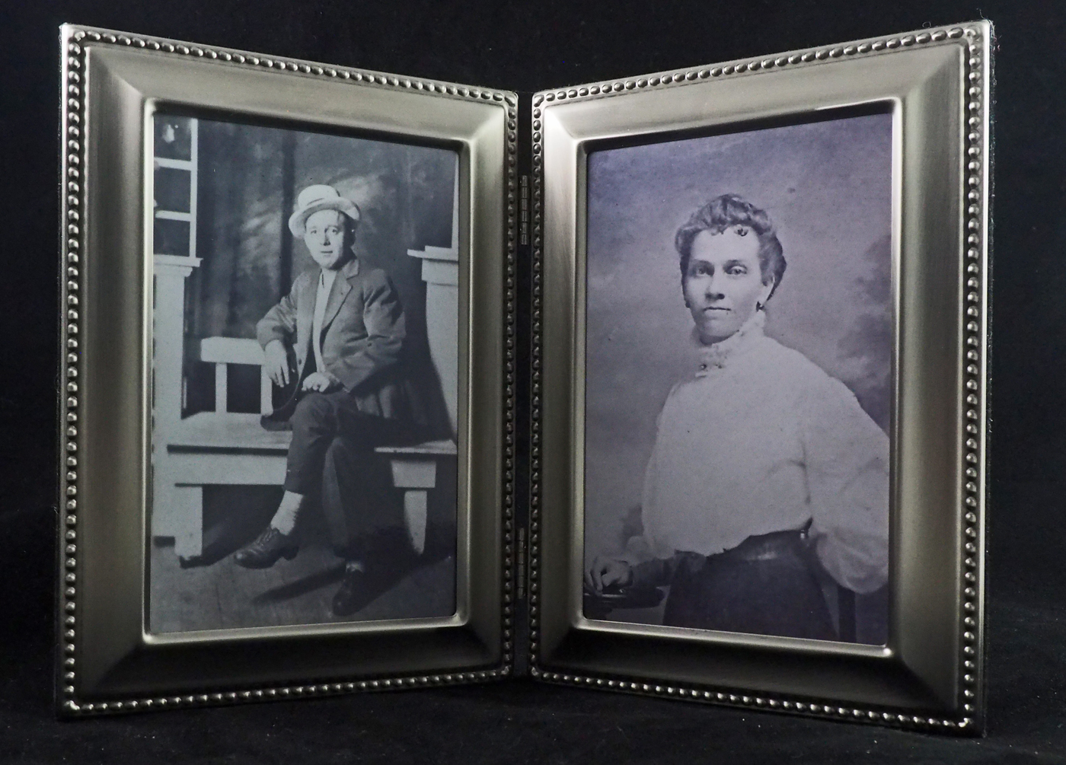
Photographic Gems: Displaying
a. framed art

Slide 35
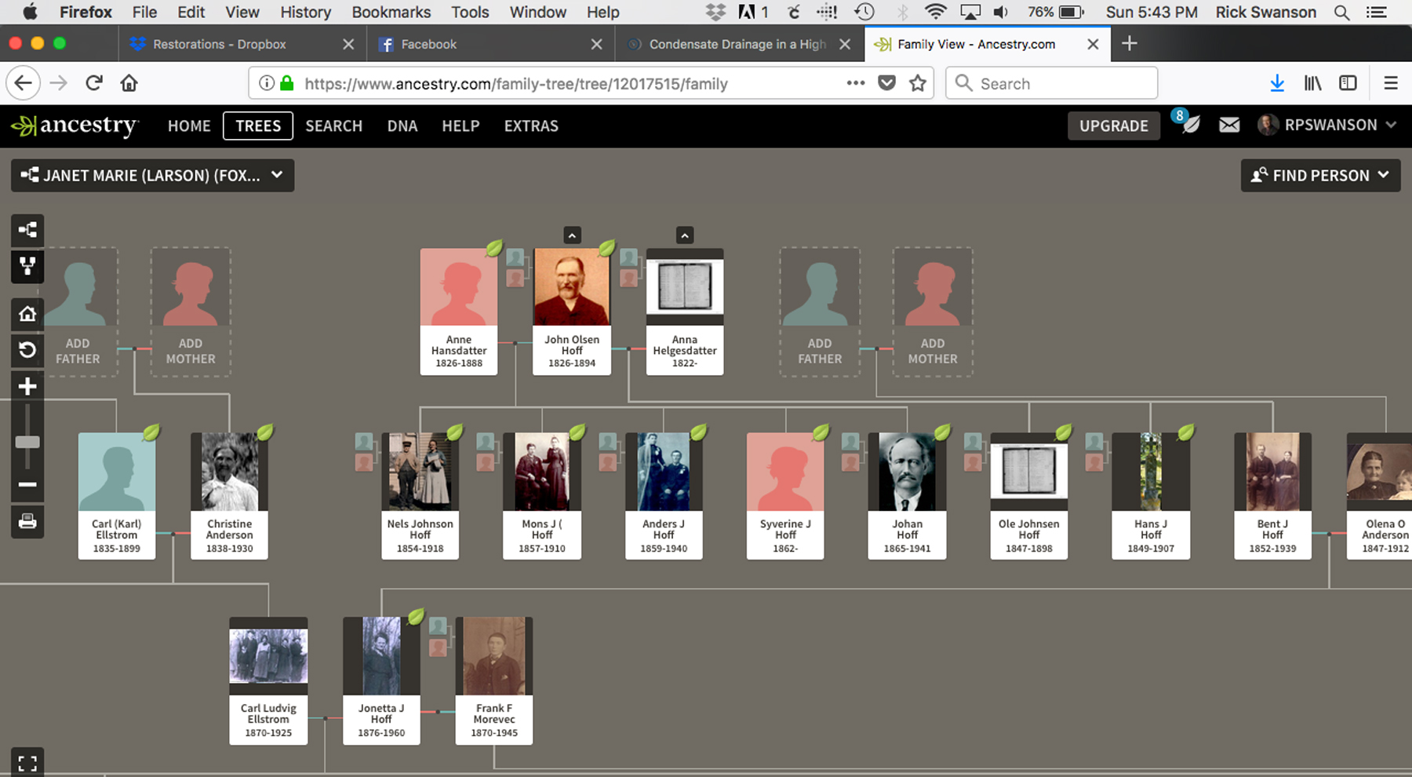
Photographic Gems: Displaying
b. electronic trees

Slide 36
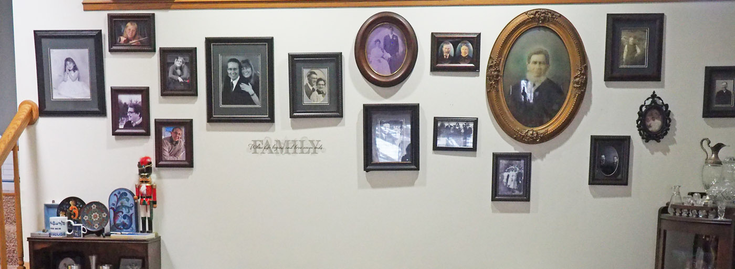
Photographic Gems: Displaying
c. wall displays

Slide 37
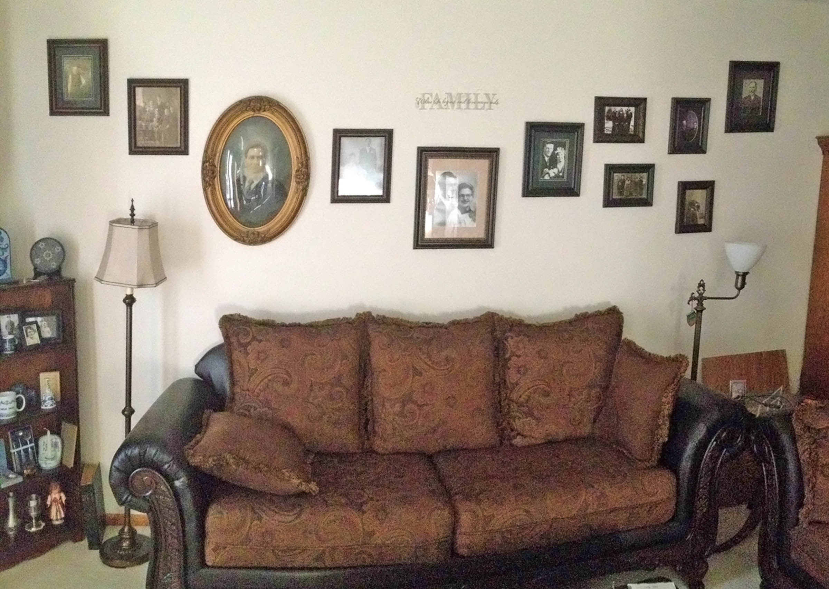
Photographic Gems: Displaying
c. wall displays

Slide 38
Photographic Gems: Displaying
d. albums

Slide 39
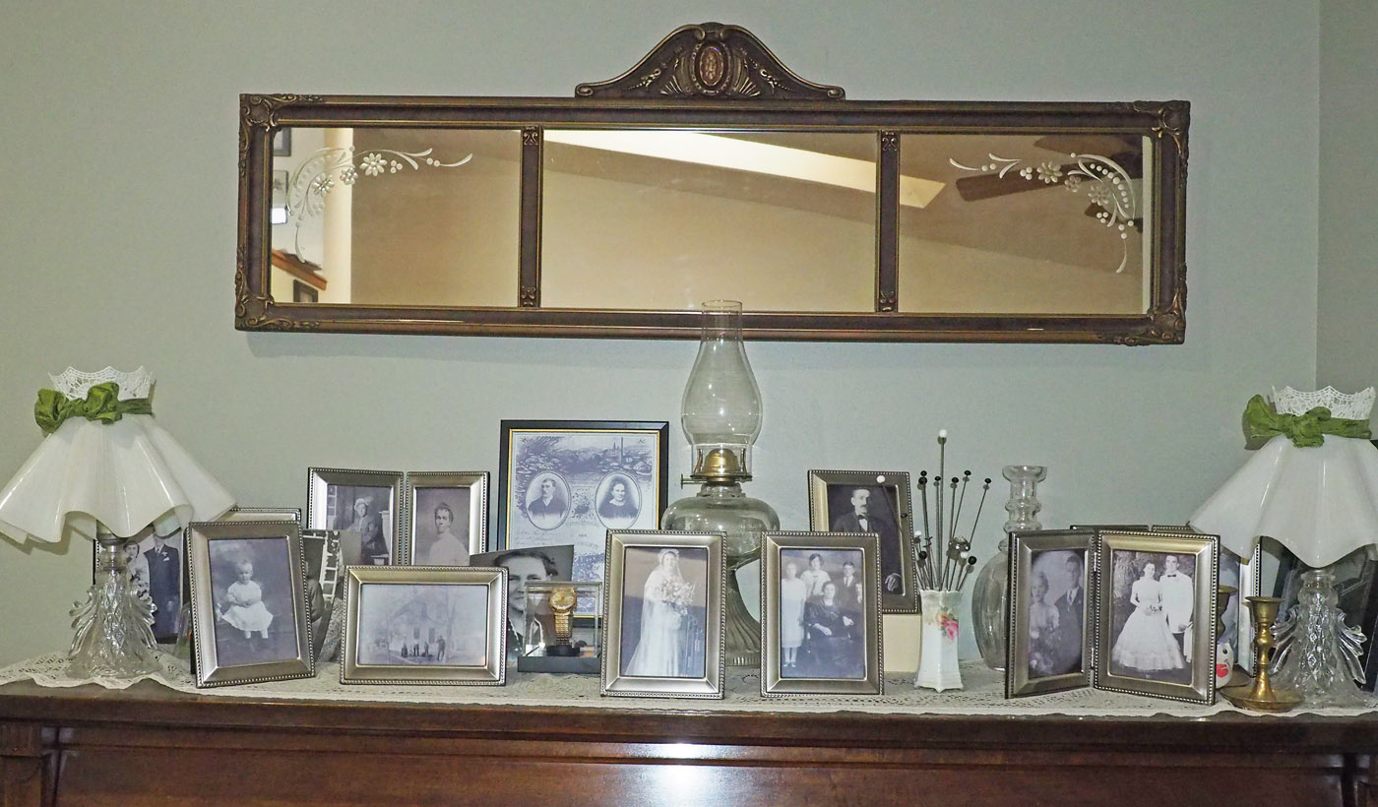
Photographic Gems: Displaying
e. other displays

Slide 40
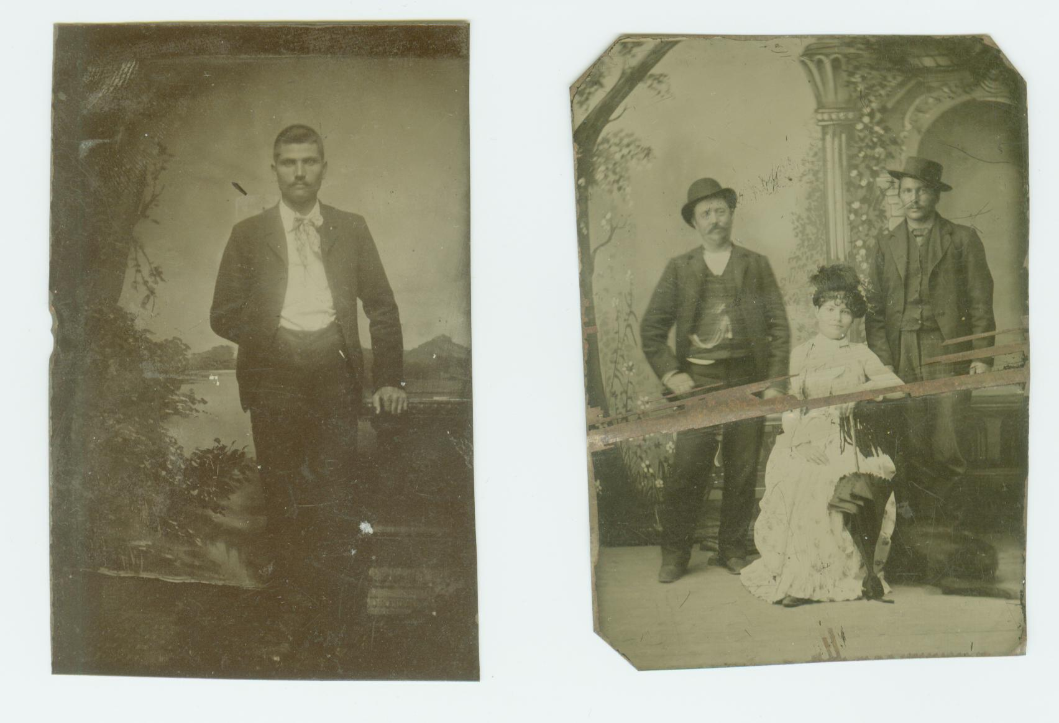
Beyond the Photo: Telling the Story
a. mysteries
b. discoveries
c. publishing

Slide 41
Beyond the Photo: Telling the Story
Your turn
  What’s your favorite story about one of your photos?
  What’s your most intriguing mystery?

Slide 42
Questions

Slide 43
Fox and Swan Arts
Digital Restoration
Digital Conversion
Special Projects
rick@foxswanarts.com
651-338-1349
http://foxswanarts.com

